Slide 1
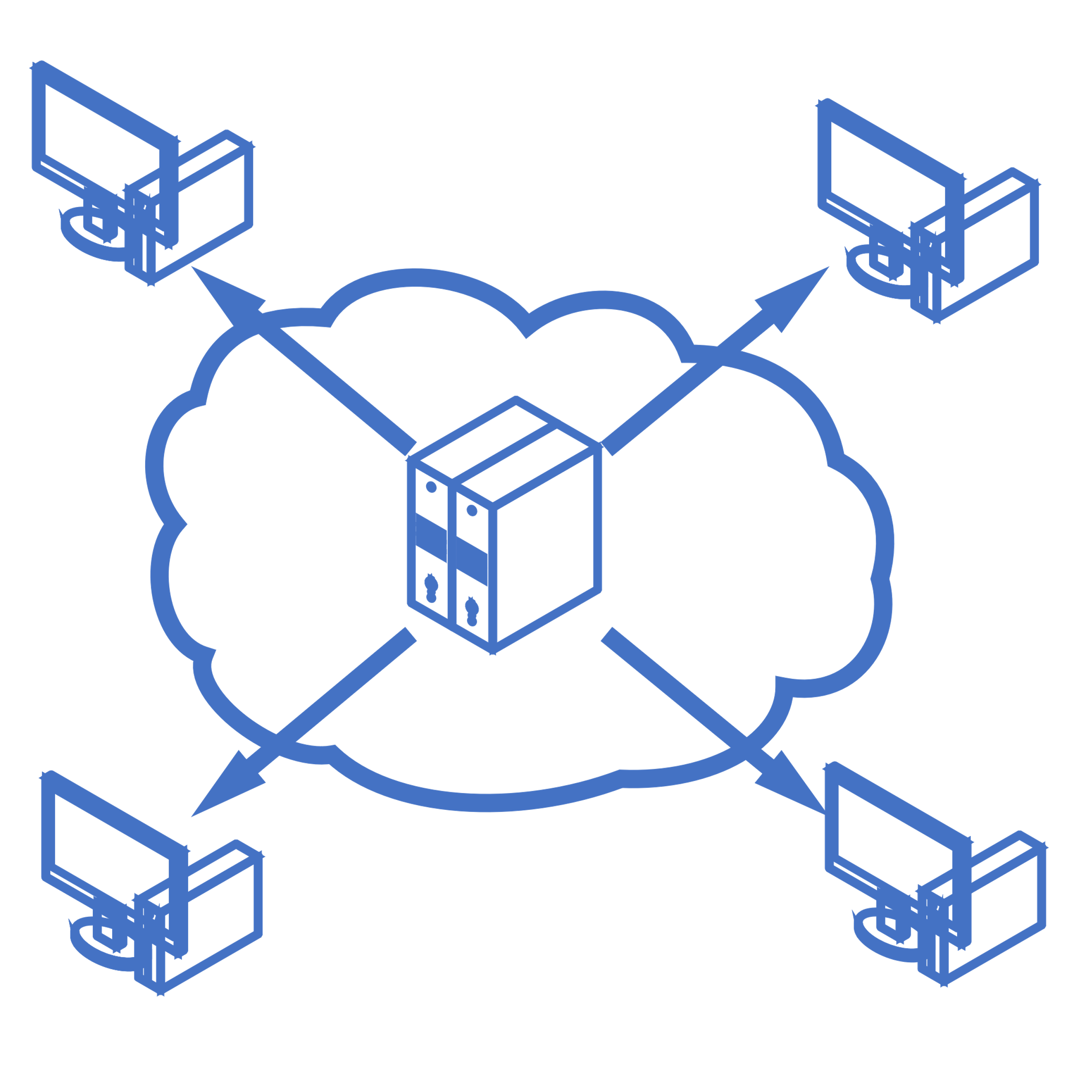
Federative Learning
Sajjad Ranjbar

Slide 2
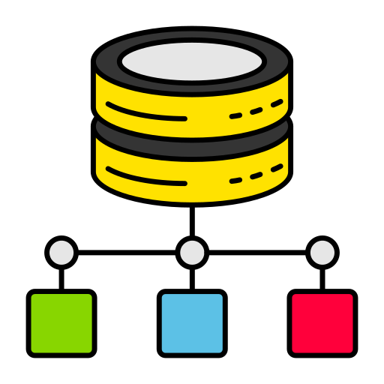
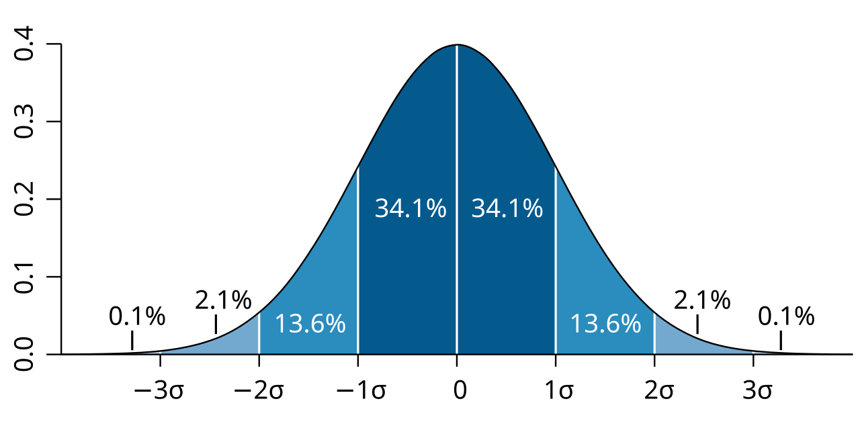
Classical Machine learning
Dataset
model
Destribution

Slide 3
Classical Machine learning
The volume of data is enormous
Data is confidential
Dataset

Slide 4
Classical Machine learning
The volume of data is enormous
A single server must compute all processes
Dataset
Data is confidential
Medical information, banking transactions, etc.

Slide 5
Federated learning
Federated learning is a distributed machine learning approach where multiple devices or entities collaborate to train a shared model without exchanging raw data. This allows for data privacy and security while still enabling collaborative model improvement.
Federated learning is a distributed machine learning approach where multiple devices or entities collaborate to train a shared model without exchanging raw data. This allows for data privacy and security while still enabling collaborative model improvement.

Slide 6



Federated learning
Local data
Client1
Client2
Server
Global Model
Client3

Slide 7
Federated learning
Local data
W₁
Client1
W₂
Client2
Server
W₃
Client3

Slide 8
Federated learning
Local data
Client1
W = F(W₁, W₂, W₃)
Client2
Server
Client3

Slide 9
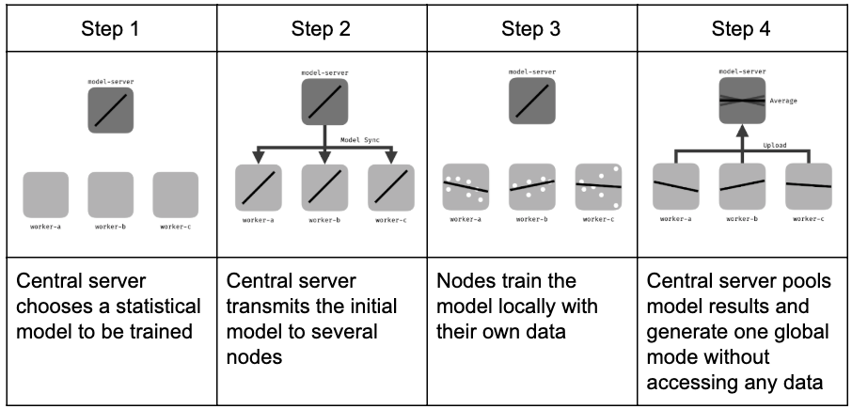
Federated learning

Slide 10

Federated learning
Even in FL, model weights may provide the original data.
Solution: Encrypt weights before sending to the server.
Challenge: The server must be able to perform aggregation operations on encrypted weights.
Homomorphic Encryption

Slide 11
Homomorphic encryption
A type of encryption that allows calculations to be performed on encrypted data without the need to decrypt it.
Enc(x ¤ y) = Enc(x) ¤ Enc(y)

Slide 12
Federated learning
Local data
Enc(W₁)
Client1
Enc(W₂)
Client2
Server
Enc(W₃)
Client3

Slide 13
Federated learning
Local data
Client1
Client2
Server
W = F(Enc(W₁), Enc(W₂), Enc(W₃))
Client3

Slide 14
Federated learning
Real example
label | text | id
Suicide | … | 1
Non-suicide | … | 2
Link

Slide 15
example
Many Classical models have been tested on this dataset. You can see a good example in this notebook. The following methods have been tested on this netbook:
Naive Bayes (Voting Classifier)
Random Forest
Decision Tree
Gradient Boosting
XG Boost

Slide 16

Federated learning based on naive bayes
Local data
W₁
Client1
Naive Bayes
Server
W₂₀
W = $\frac{1}{20}\sum_{i=1}^{20}{w_{i}}$
Client20

Slide 17
Results
Federated model(20 clients) | Classical model
- | 88.02% | Train Accuracy
88.53 | 88.06% | Test Accuracy
0.89 | 0.86 | Precision
0.88 | 0.91 | Recall
0.89 | 0.88 | F1-score

Slide 18
Thank you so much

